Slide 1
DETERMINANTS

Slide 2
INTRODUCTION TO DETERMINANTS

Slide 3
Determinants
2*2 matrix is invertible if and only if its determinant is nonzero.
extend this useful fact to larger matrices
definition for the 3*3 case
DETERMINANT

Slide 4
Determinants
To generalize the definition of the determinant to larger matrices, we’ll use 2*2 determinants to rewrite the 3*3 determinant  described above.
let Aij denote the submatrix formed by deleting the i th row and j th column of A.

Slide 5
Determinants
In general, an n*n determinant is defined by determinants of (n-1)*(n-1) submatrices.

Slide 6
Determinants
cofactor expansion across the first row of A

Slide 7
Determinants
helpful for computing the determinant of a matrix that contains many zeros

Slide 8
Determinants

Slide 9
Determinants

Slide 10
example

Slide 11
PROPERTIES OF DETERMINANTS

Slide 12
Determinants

Slide 13
Determinants

Slide 14
Determinants
Suppose a square matrix A has been reduced to an echelon form U
If there are r interchanges, then Theorem shows that

Slide 15
Determinants

Slide 16
Determinants

Slide 17
Column Operations
operations on the columns of a matrix similar to the row operations
column operations have the same effects on determinants as row operations.
each statement in Theorem 3 is true when the word row is replaced everywhere by column.

Slide 18
Determinants and Matrix Products

Slide 19
example

Slide 20
Proof of theorem 3
The proof is by induction on the size of A
expand det(EA) across an unchanged row by the action of E, say, row i (B=EA)

Slide 21
Proof of theorem 3

Slide 22
PROOF OF THEOREM 6

Slide 23
CRAMER'S RULE, VOLUME, AND LINEAR TRANSFORMATIONS

Slide 24
Cramer’s Rule

Slide 25
Cramer’s Rule

Slide 26
Example

Slide 27
Example

Slide 28
A Formula for A^{–1}

Slide 29
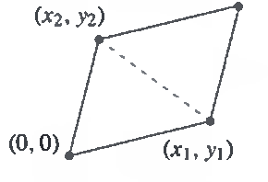
Determinants as Area or Volume

Slide 30
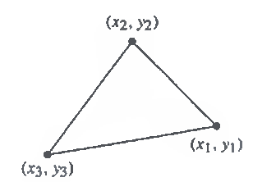
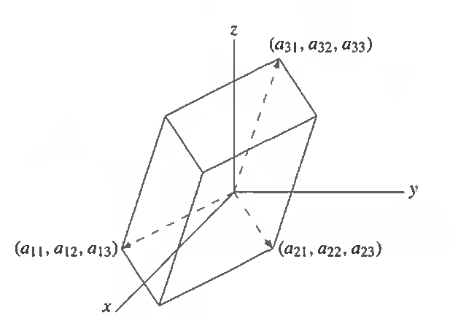
Determinants as Area or Volume

Slide 31
Linear Transformation
parallelogram determined by the columns of the matrix . Ab1 Ab2

Slide 32
Linear Transformation

Slide 33
example
image of the unit disk D

Slide 34
09177174707

